Slide 1

DEPARTMENT OF ARTIFICIAL INTELLIGENCE AND DATA SCIENCE
AGI1242 - MACHINE LEARNING TECHNIQUES
BATCH 3
Presented By:
2503811724322075 – Pratheepa G
2503811724322086 – Roshini D
2503811724322090 – Sanjanaa S
2503811724322099 – Shree Harini K A
2503811724321121 – Vishal S
Guided By:
Mr.P.Aravind Prasad
B.E., M.Tech.
Department of AI&DS

Slide 2


CampusPass: Privacy-Aware Student
Entry & Exit Notification System
2

Slide 3
PRESENTATION OVERVIEW
➢ Objective
➢ Problem Identification
➢ Flow Diagram
➢ Literature Survey
➢ System Architecture Diagram
➢ Research Methodology (Algorithm Explanation)
➢ Existing System Drawbacks
➢ Compare Algorithm
➢ Proposed System
➢ Implementation Idea
➢ Identified Modules
➢ Conclusion
3

Slide 4
OBJECTIVE
To develop a privacy-aware campus gate system for automated student ENTRY/EXIT detection.
To identify registered students using RFID-enabled ID cards.
To record only the minimum gate-event information required for notification.
To study suspicious/abnormal gate-event patterns using machine-learning techniques.
To compare One-Class SVM and DBSCAN for Normal / Suspicious Event Anomaly Detection.
To select the better-performing model using Accuracy, Precision, Recall, F1-Score and ROC-AUC.
4

Slide 5
PROBLEM IDENTIFICATION
RFID-based attendance and access systems can automate student identification, but many existing systems focus mainly on recording attendance.
RFID UID validation alone cannot determine whether an event pattern is normal or suspicious, such as repeated rapid scans or unusual entry/exit sequences.
Some recent systems use cloud services, cameras or biometric verification, increasing infrastructure and privacy concerns.
Continuous location tracking is unnecessary for a campus gate notification requirement.
Therefore, a privacy-aware gate-event system with an ML-based suspicious-event classification layer is proposed.
5

Slide 6
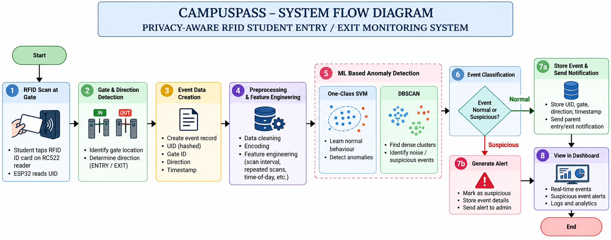
FLOW DIAGRAM

Slide 7
LITERATURE SURVEY
S.No | Study / Year | Focus / Key Finding | Limitation / Gap
1 | Irahmanna et al. (2026) | RFID + ESP32 + RC522 + MySQL for real-time student attendance. | Attendance-focused; does not address privacy-aware gate notification.
2 | Pardani & Yulianti (2026) | RFID + ESP32 + cloud + smart door lock; UID validation and access control. | Cloud latency/stability; not parent-notification focused.
3 | Charulatha et al. (2026) | ESP32 + RC522 RFID; registered-ID matching and access decision. | RFID validates identity but does not analyze suspicious event patterns.
4 | Hutabarat et al. (2026) | RFID + ESP32 + MySQL + web interface for campus presence management. | Primarily attendance management; limited privacy-aware event intelligence.
5 | Ege & Özdemir (2026) | Non-biometric RFID attendance with additional verification to reduce proxy attendance. | Adds verification hardware; not focused on campus gate ENTRY/EXIT notifications.
6

Slide 8
LITERATURE SURVEY
S.No | Study / Year | Focus / Key Finding | Limitation / Gap
6 | RFID IoT Identification & Attendance (2023) | RFID with camera/facial verification for entry and fraud monitoring. | Camera/biometric data increases privacy scope.
7 | RFID Attendance + IFTTT (2024) | RFID attendance with database processing and instant notifications. | Attendance-focused; no suspicious-event analysis.
8 | Intelligent Attendance & Energy (2024) | RFID + ESP32 for attendance and automated facility control. | No anomaly detection or privacy-minimization layer.
9 | RFID Attendance & Monitoring (2024) | RFID/NodeMCU with cloud-sheet based monitoring. | Monitoring-oriented; limited ML intelligence.
10 | He et al. (2024) | Optimized One-Class SVM for multivariate telemetry anomaly detection. | Telemetry-specific; not RFID gate-event data.
7

Slide 9
LITERATURE SURVEY
S.No | Study / Year | Focus / Key Finding | Limitation / Gap
11 | Unsupervised Anomaly Detection Study (2024) | Compared OCSVM, LOF, Isolation Forest and Robust Covariance. | Evaluation context differs from campus gate-event sequences.
12 | Muzakir & Hendri (2025) | IoT + RFID attendance backend with real-time data management. | Attendance/management focus; no event anomaly model.
13 | Darmi et al. (2025) | RFID + ESP32 + WhatsApp notification for real-time attendance. | Notification-centric; no suspicious sequence detection.
14 | Enhanced Student Attendance (2025) | RFID + IoT + real-time database and web communication. | Attendance UX focus; not privacy-aware anomaly detection.
15 | Student Attendance System Using RFID (2026) | RFID-based student attendance and access monitoring. | Attendance system; no ML anomaly comparison.
8

Slide 10
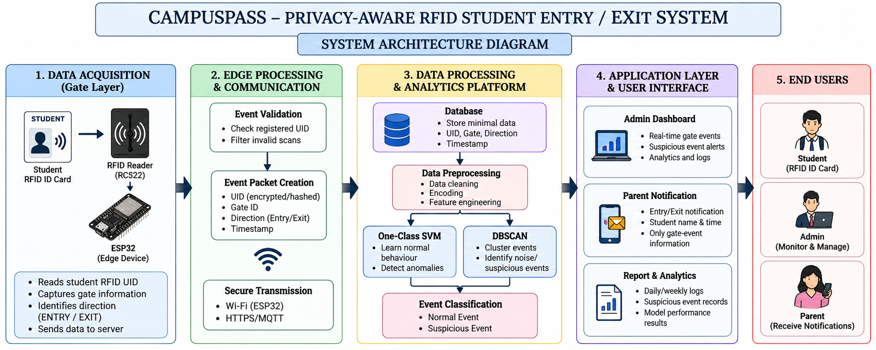
SYSTEM ARCHITECTURE DIAGRAM
9

Slide 11
RESEARCH METHODOLOGY
ALGORITHM 1
ONE-CLASS SVM
Learns a boundary around normal event behaviour.
ALGORITHM 2
DBSCAN
Finds dense event groups and noise points.
EVALUATION
Accuracy, Precision, Recall,
F1-Score and ROC-AUC.
Collect and prepare gate-event feature vectors.
Scale/encode the event features before modeling.
Train One-Class SVM on normal-event behaviour.
Apply DBSCAN to identify dense groups and noise.
Classify events as Normal or Suspicious.
Compare both algorithms using the selected evaluation metrics.
13

Slide 12
EXISTING SYSTEM
DRAWBACKS:
RFID systems mainly record attendance or access events.
A registered UID is generally accepted or rejected using rule-based validation.
Many systems store attendance records in local or cloud databases.
Some systems add smart locks, dashboards, cameras or biometric verification.
Parent notification is not the primary focus in most attendance systems.
RFID alone does not identify suspicious event patterns such as unusual repeated scans.
Continuous tracking or biometric methods can create additional privacy concerns.
11

Slide 13
COMPARE ALGORITHM
Criterion | One-Class SVM | DBSCAN
Learning idea | Learns a boundary around normal behaviour. | Finds dense clusters and labels sparse points as noise.
Main parameters | ν, kernel and γ. | ε and MinPts.
Best fit | Normal-behaviour modelling with limited anomaly labels. | Density-based event grouping and outlier discovery.
Non-linear patterns | Strong with suitable kernels. | Naturally handles irregular cluster shapes.
Sensitivity | Sensitive to scaling and parameter selection. | Sensitive to ε/MinPts and varying density.
CampusPass role | Primary one-class boundary model to test. | Alternative density-based anomaly model to test.
Final selection | Based on Accuracy, Precision, Recall, F1-Score and ROC-AUC. | Based on the same evaluation metrics.
14

Slide 14
PROPOSED SYSTEM
RFID Student Identification – Reads the unique UID from the student's RFID-enabled ID card.
Gate Event Detection – Identifies the gate and classifies the event as ENTRY or EXIT.
Data Preprocessing – Cleans and encodes event records before analysis.
Feature Engineering – Derives scan interval, repeated-scan count, time-of-day and entry/exit sequence features.
ML Anomaly Detection – Compares One-Class SVM and DBSCAN for normal/suspicious event detection.
Secure Event Management – Stores only UID, gate, direction and timestamp required for the gate event.
Parent Notification – Sends a simple notification for confirmed student ENTRY/EXIT events.
12

Slide 15
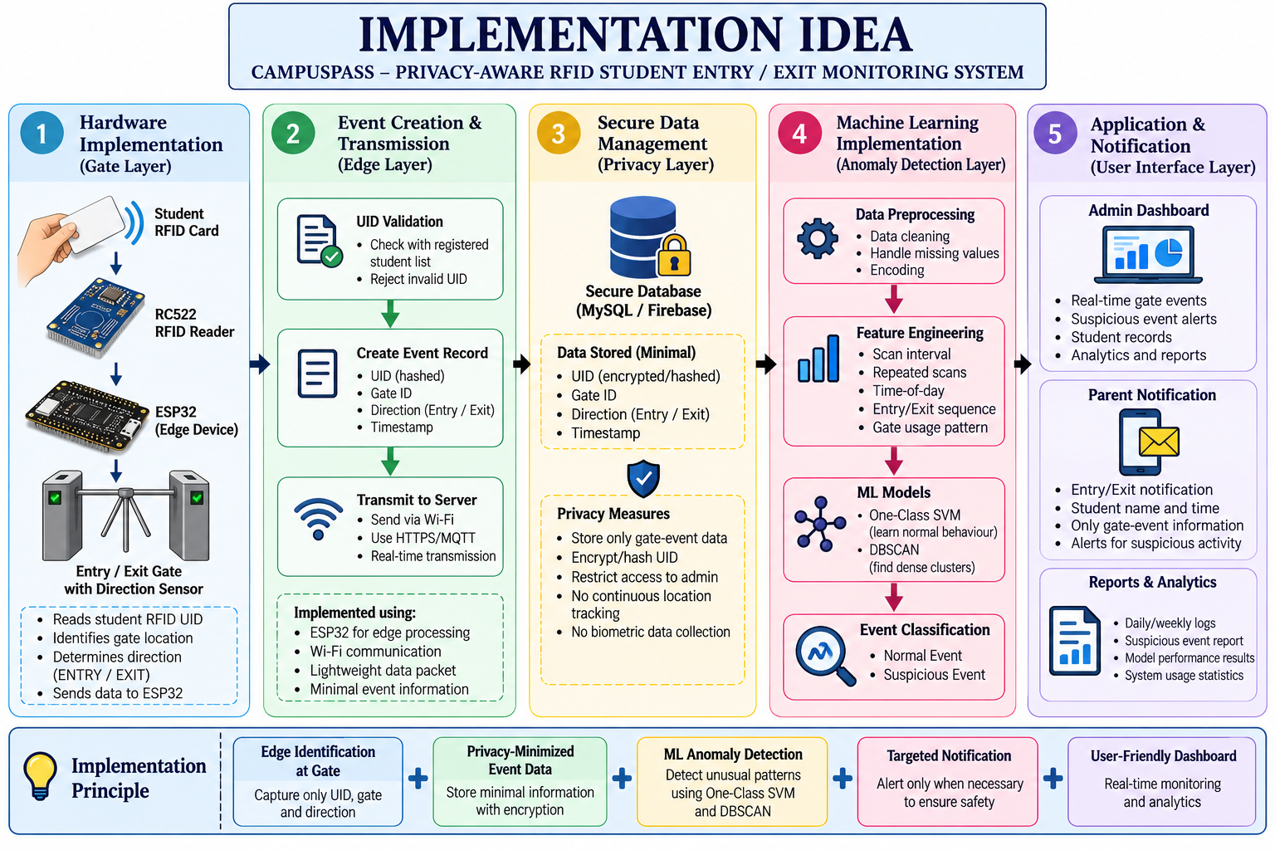
IMPLEMENTATION IDEA
15

Slide 16
IDENTIFIED MODULES
MODULE 1
RFID Student Identification
Reads and validates the student UID.
MODULE 2
Gate Detection
Determines ENTRY or EXIT from the gate reader.
MODULE 3
Event Feature Engineering
Generates features from gate-event history.
MODULE 4
ML Anomaly Detection
Compares One-Class SVM and DBSCAN.
MODULE 5
Database & Parent Notification
Stores the gate event and sends the parent alert.
16

Slide 17
CONCLUSION
The proposed CampusPass system changes campus entry/exit monitoring from simple RFID recording to privacy-aware intelligent event analysis.
RFID and ESP32 provide the basic identification and gate-event pipeline.
One-Class SVM and DBSCAN provide two ML approaches for Normal / Suspicious event anomaly detection.
Their performance will be compared using Accuracy, Precision, Recall, F1-Score and ROC-AUC.
The better-performing model will be selected from experimental results rather than assumed in advance.
The final system provides parent notification while avoiding continuous student location tracking and biometric data collection.
17

Slide 18
THANK YOU
18

